Slide 1
Bhuruz oop-project

Slide 2
Hello!
We are Team Bhuruz
You can find us at
St.habib.edu.pk@ak06857 – Ali Asghar Kerai
St.habib.edu.pk@ak06865 – Areeb Adnan Khan
St.habib.edu.pk@lm06435 – Lakshman Maheshwari
St.habib.edu.pk@mm06886 – Muhammad Jazzel Mehmood

Slide 3
1.Finallized Assets
Background, Objects and Maps

Slide 4
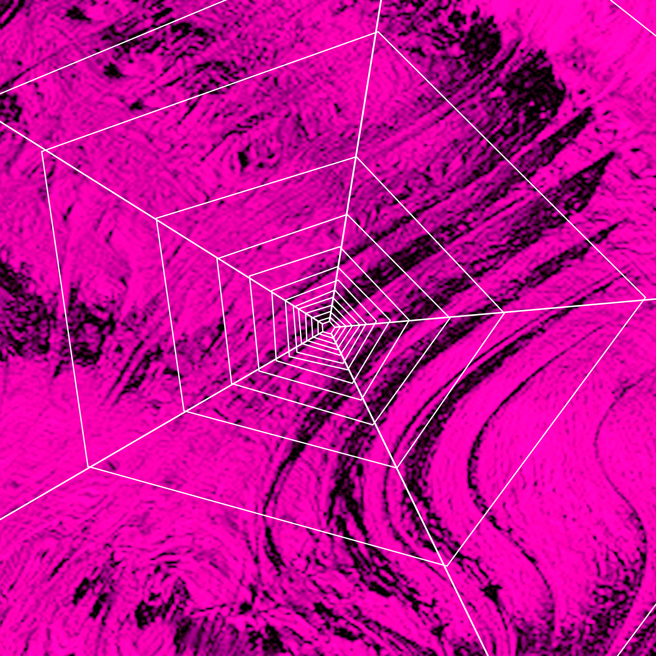
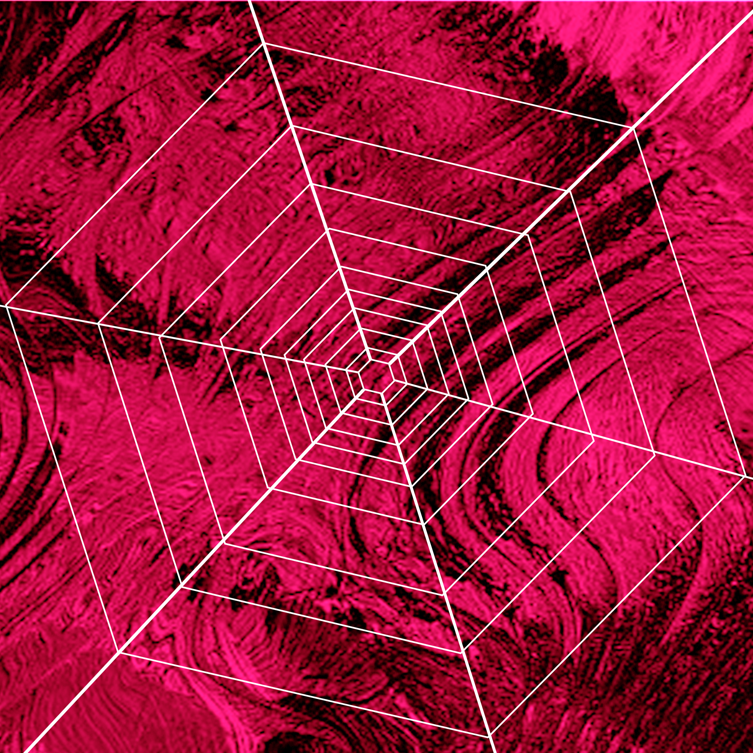
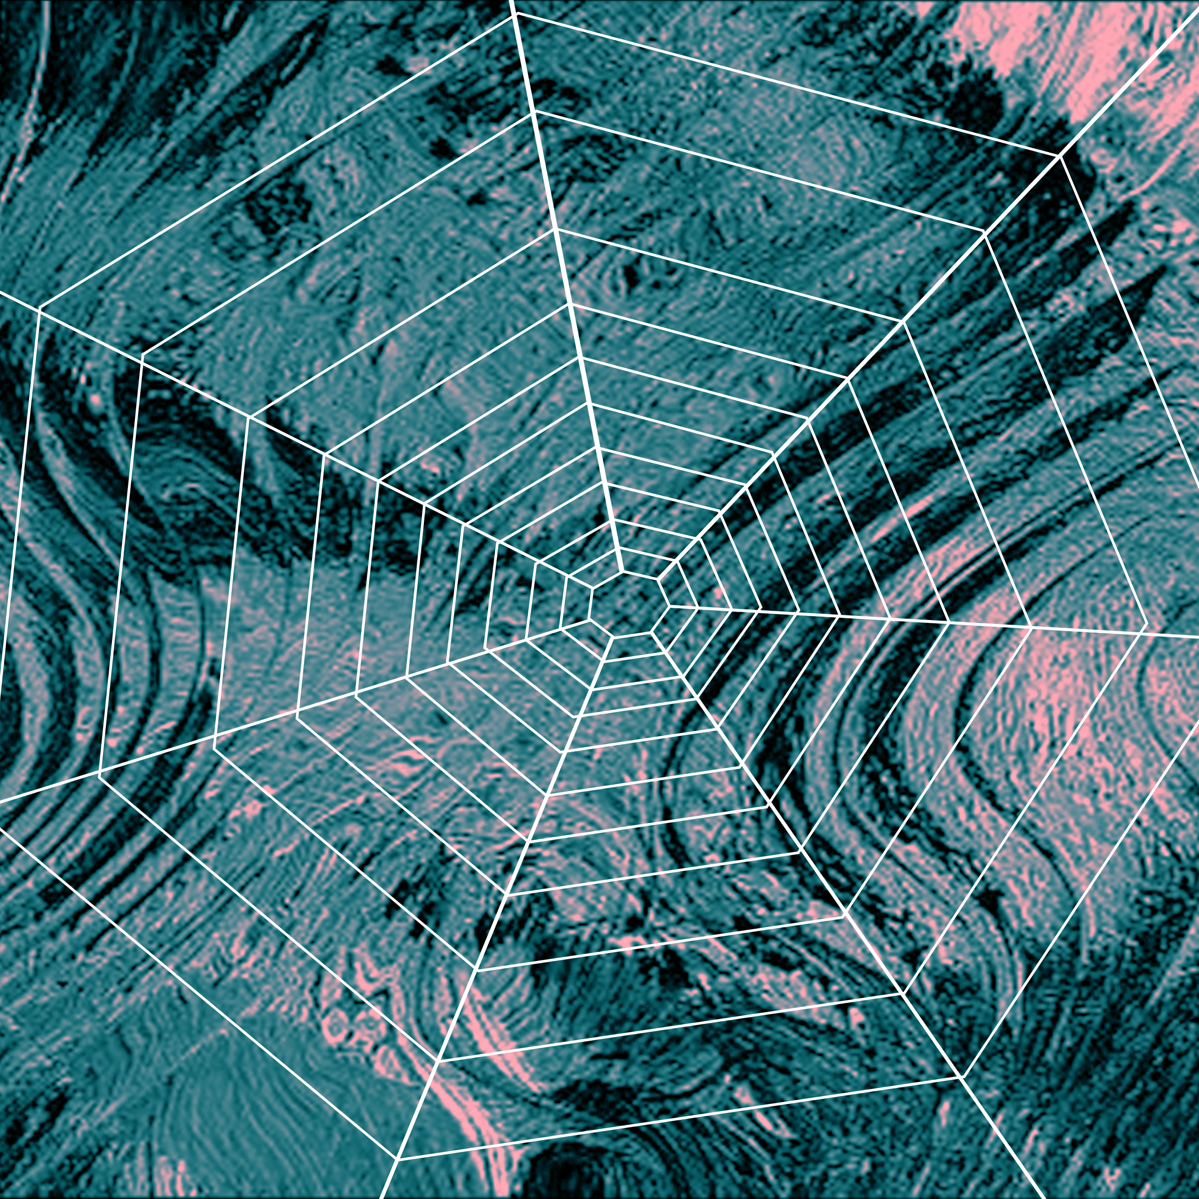
Easy
Medium
Hard

Slide 5
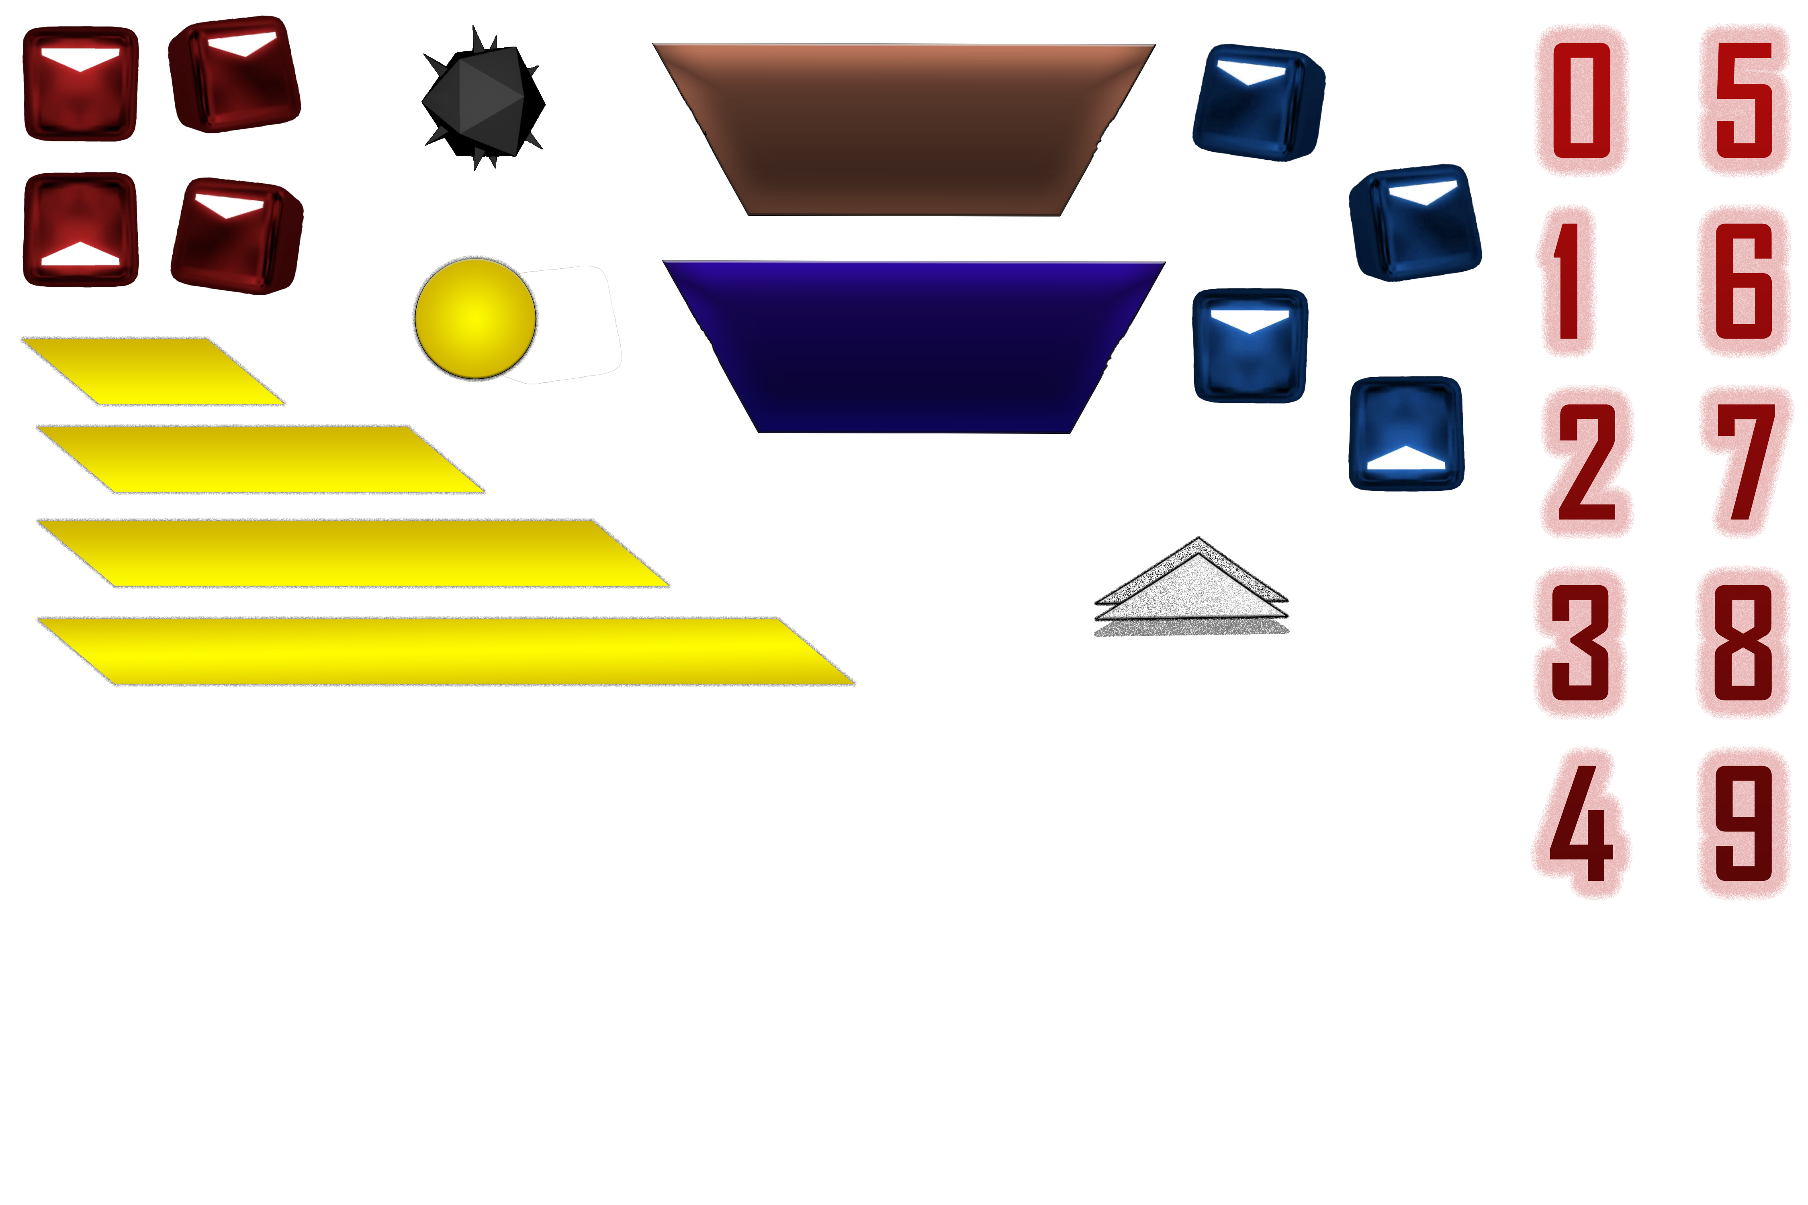
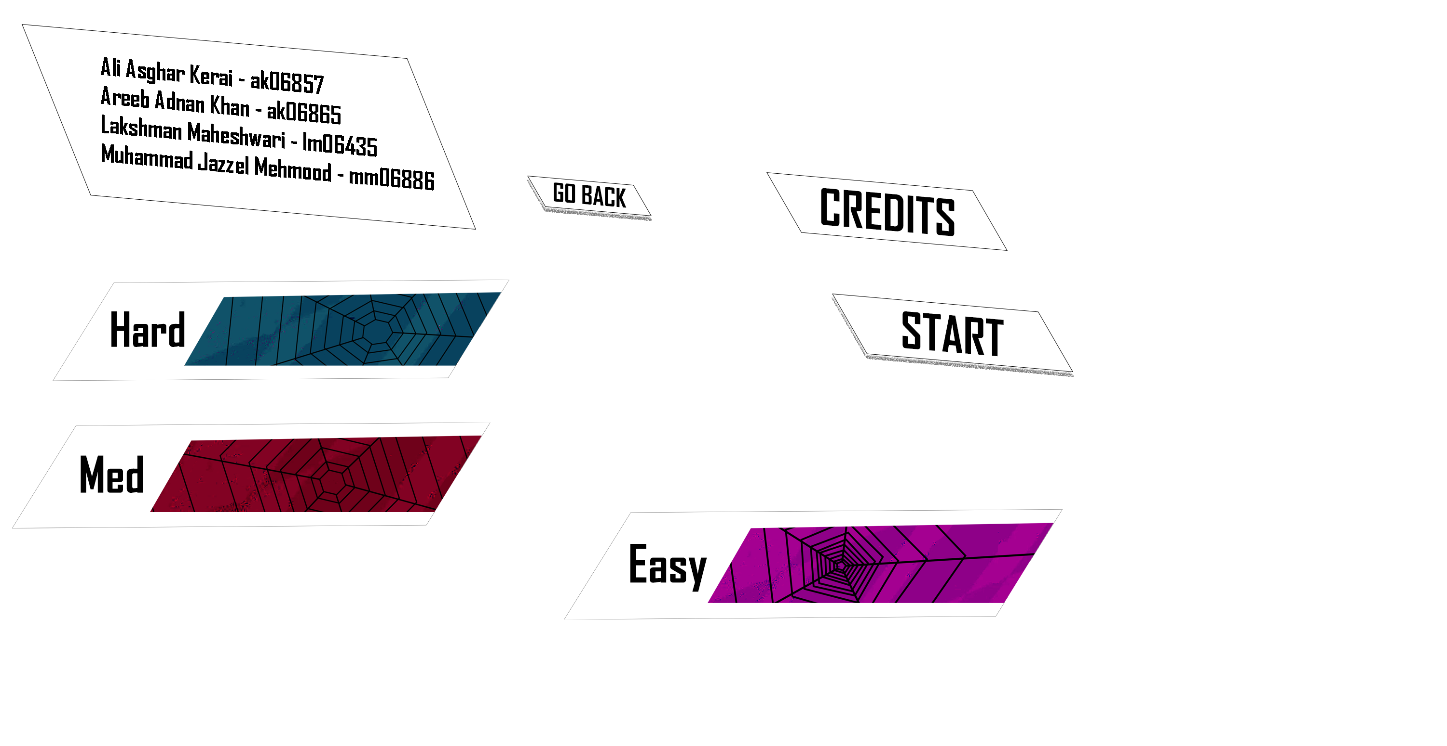

Slide 6
2.Screens
Splash Screen, Level Select &
Credits Screen

Slide 7
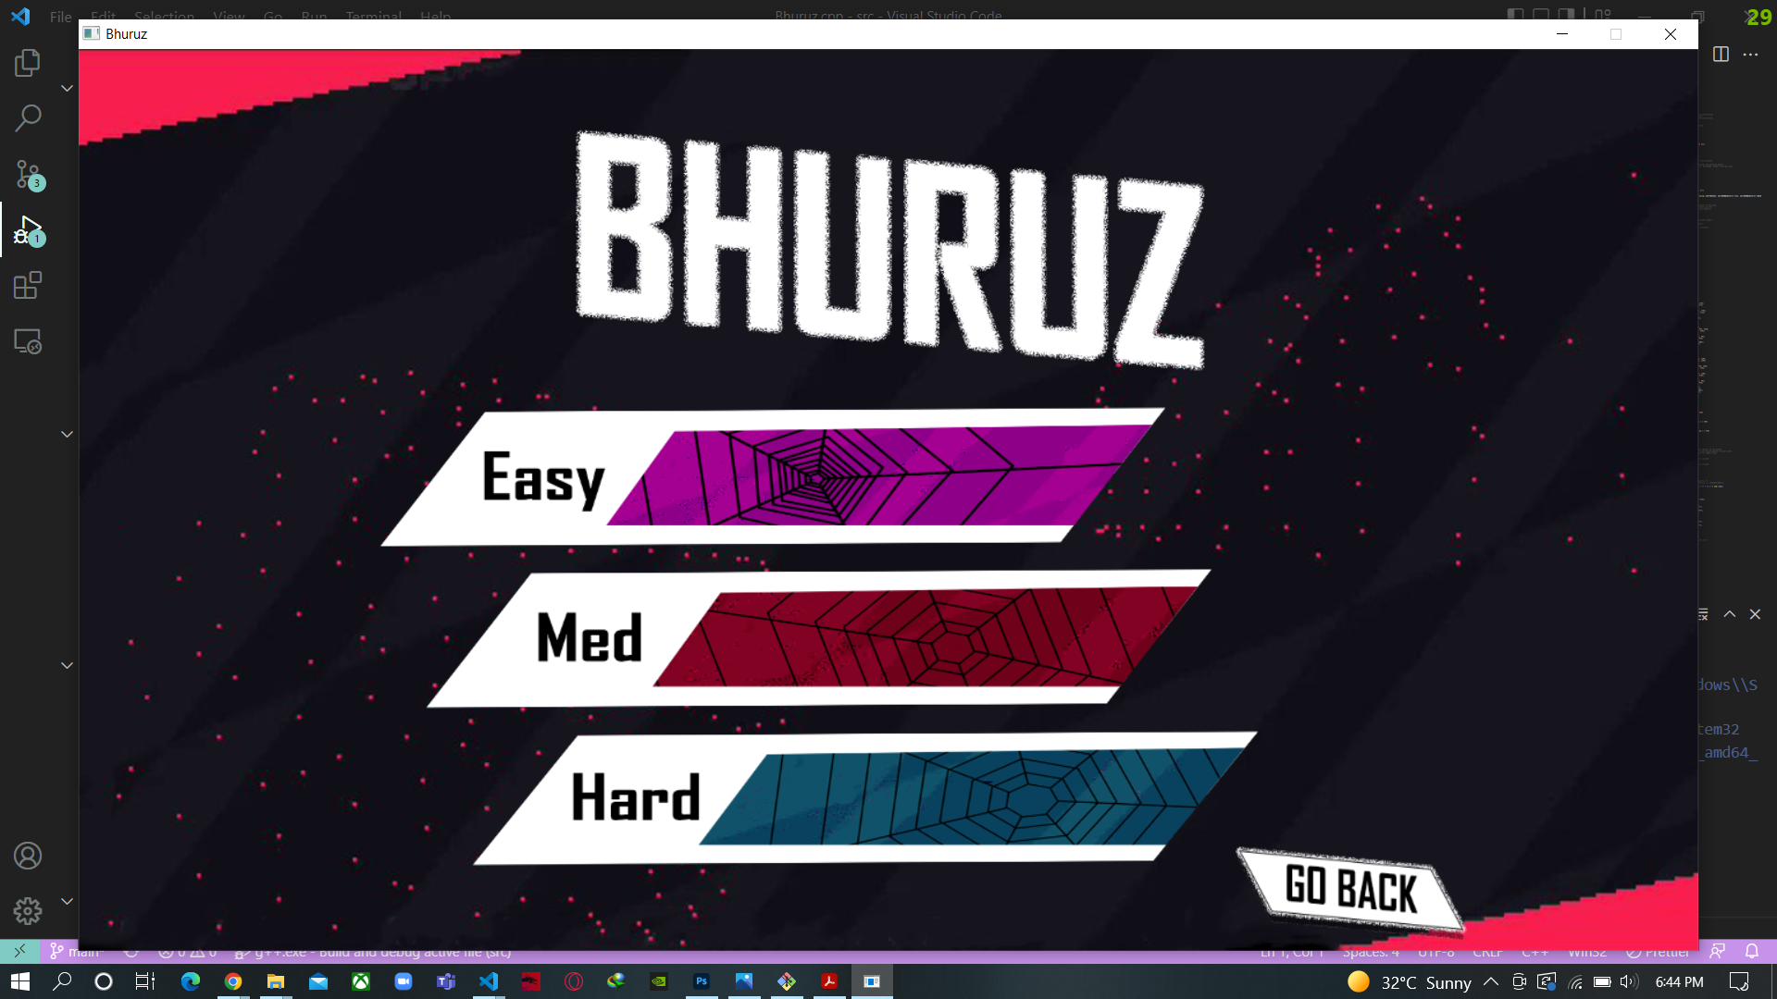
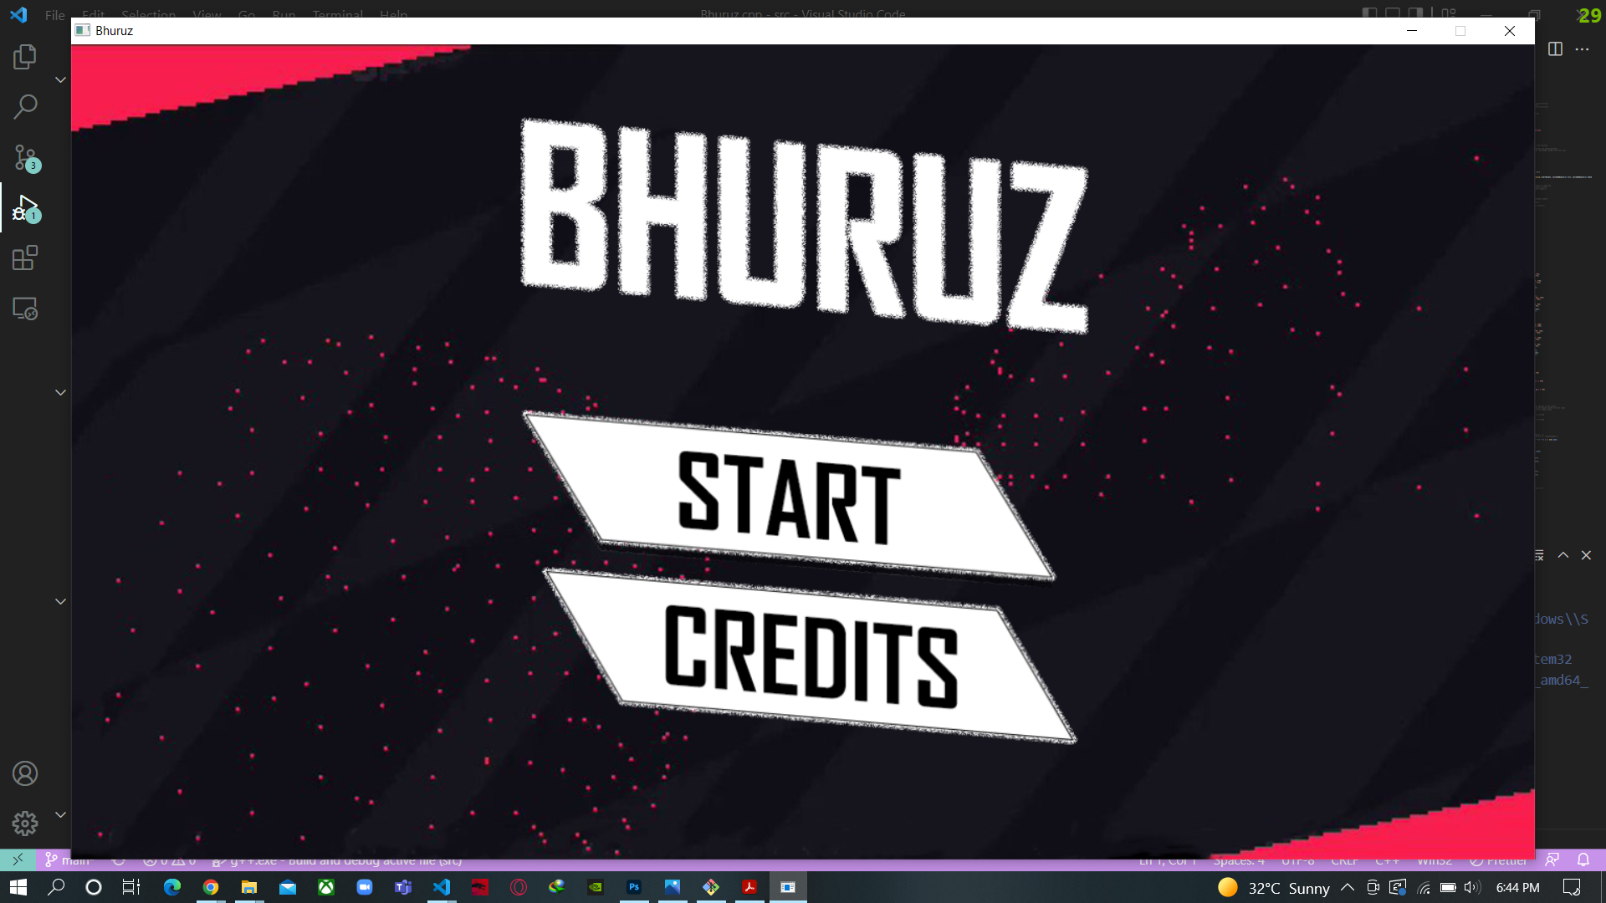
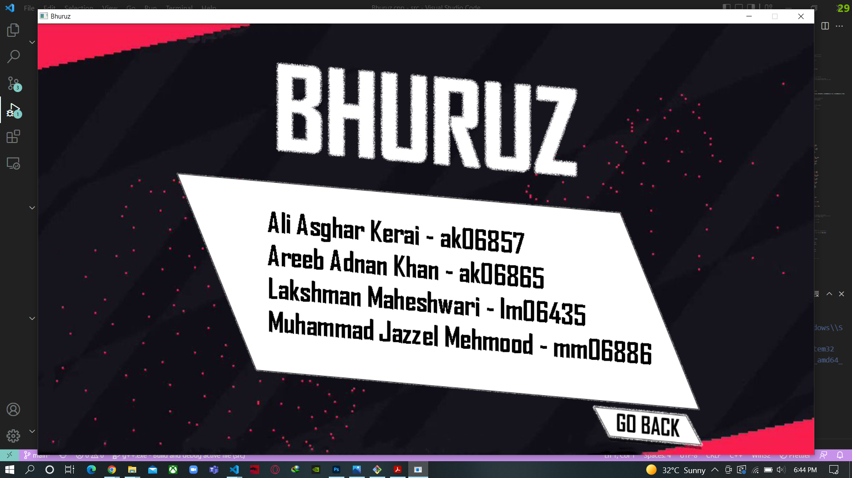
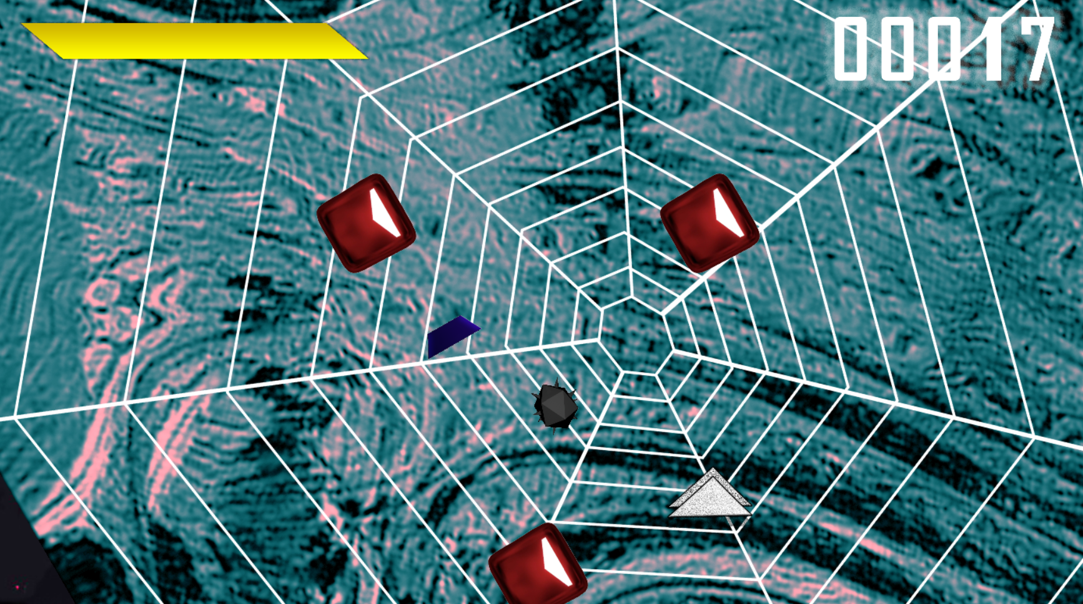
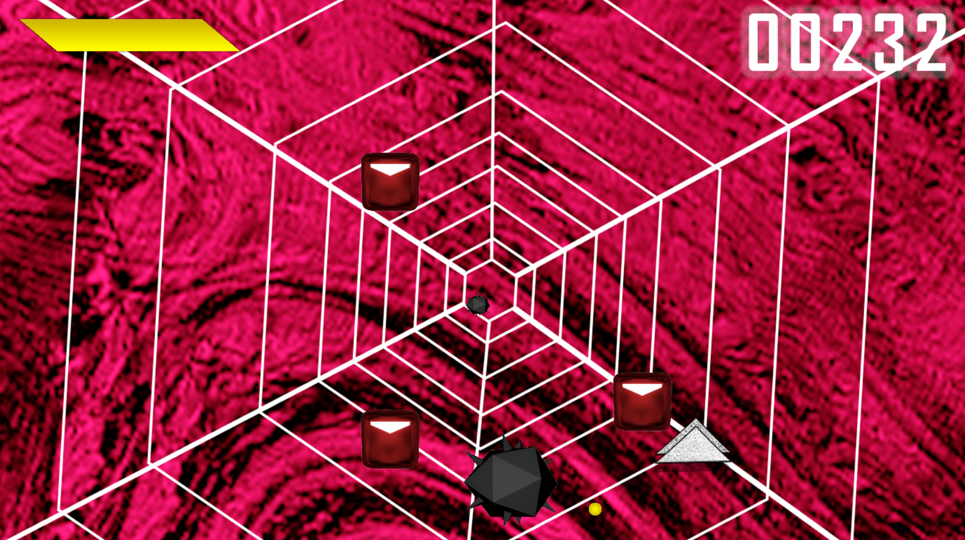
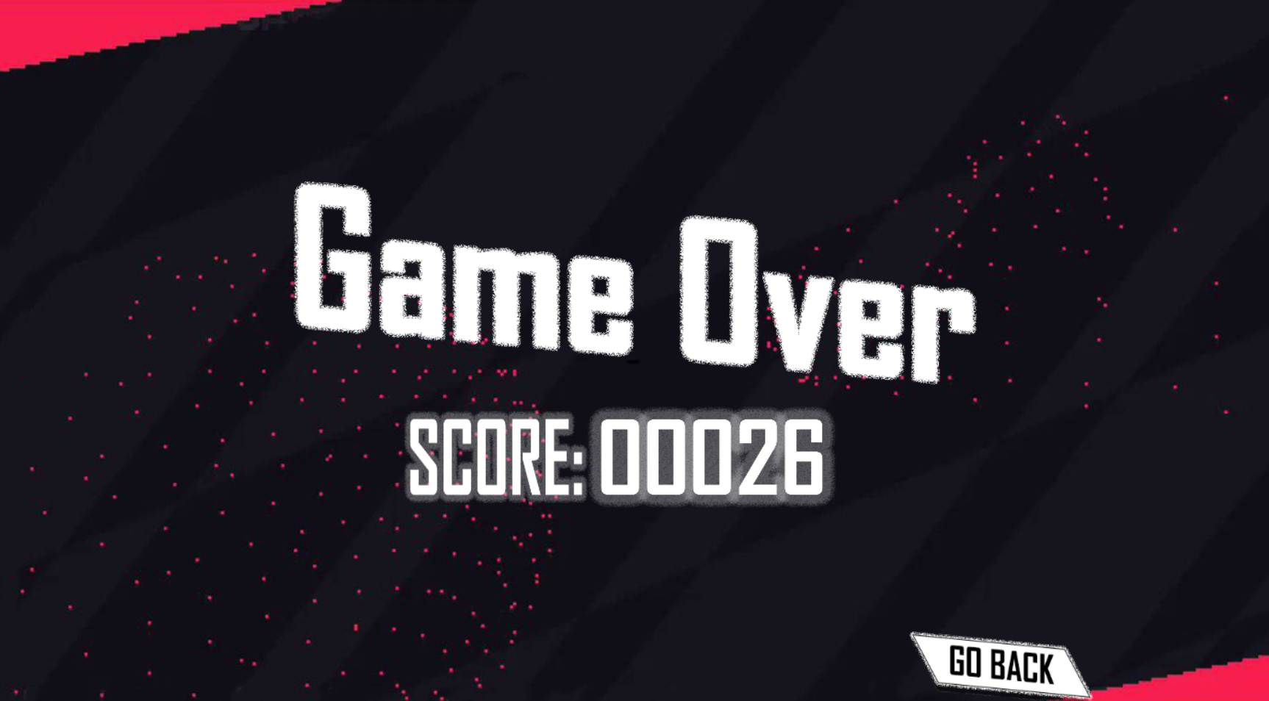
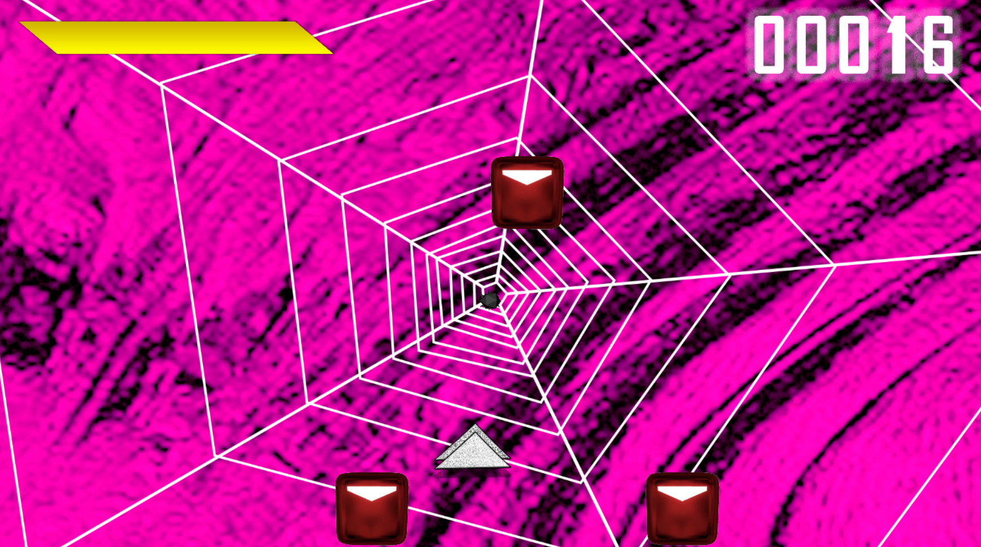

Slide 8
3.Testing finishes
Game State, Level Select, Screen Transitions
Vehicle Movement, Obstacles Creation &
Collision Detection…

Slide 9
4. Updated uml
Finallized functions, classes & attributes

Slide 10
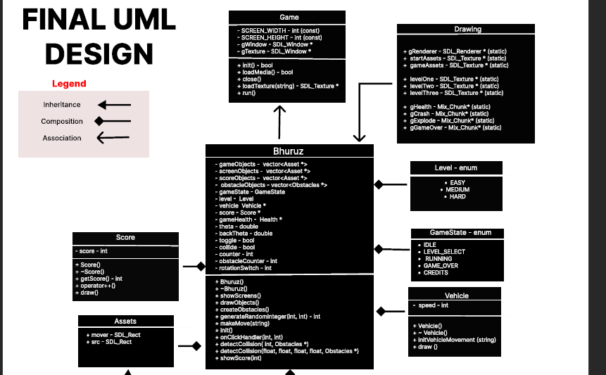

Slide 11
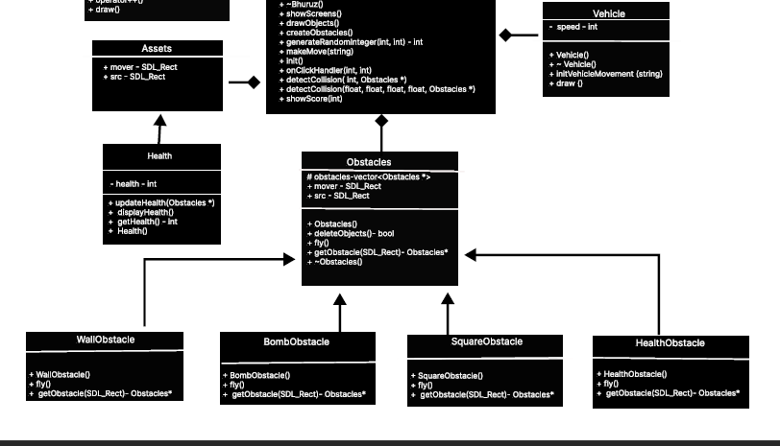

Slide 12
Thanks!
Any questions?
You can email us at
St.habib.edu.pk@ak06857 – Ali Asghar Kerai
St.habib.edu.pk@ak06865 – Areeb Adnan Khan
St.habib.edu.pk@lm06435 – Lakshman Maheshwari
St.habib.edu.pk@mm06886 – Muhammad Jazzel Mehmood

